Slide 1




FP7 STREP Project (GA 270351)
2nd Progress Meeting (2012-12-10)
Crop monitoring as an E-agriculture tool in developing countries (E-AGRI)
Overview and Management

Slide 2
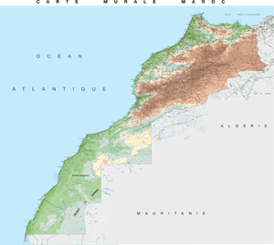
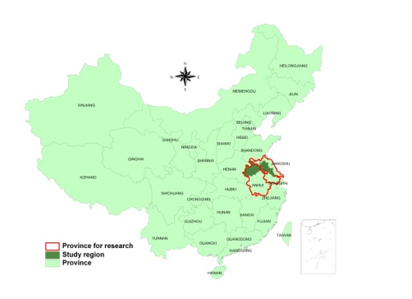
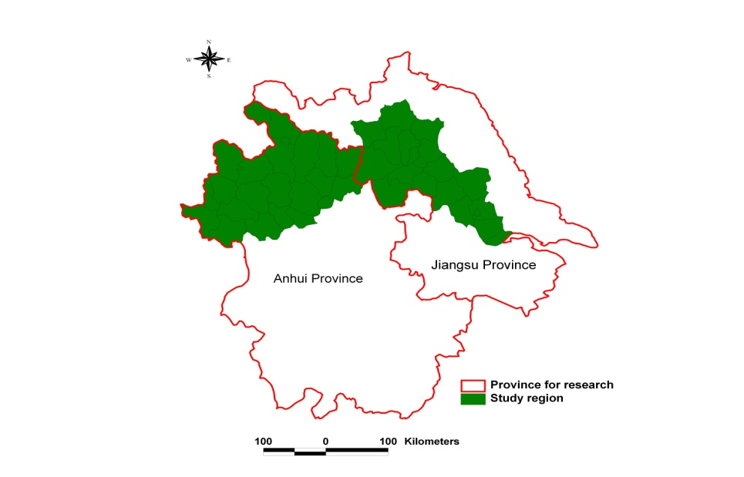
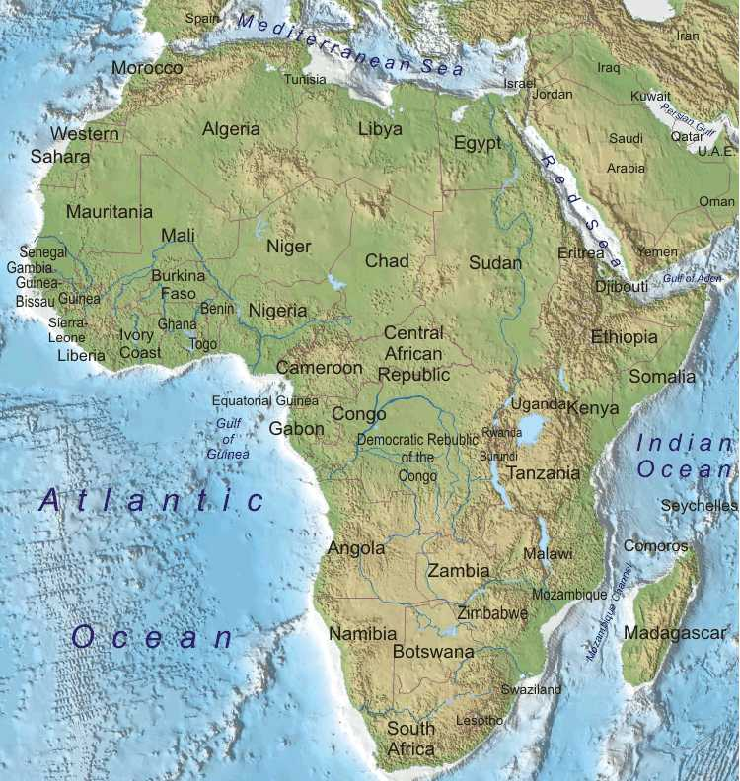
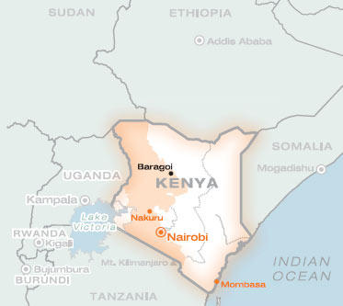
E-AGRI: 3 study areas
HuaiBei (Anhui ) and Jianghuai (Jiangsu) Plains
Morocco
Jianghuai Plain
Kenya
Huaibei Plain

Slide 3
E-AGRI: Activities
Anhui (AIFER)
Morocco (INRA)
Implementing CGMS approach targeting wheat (Alterra)
Monitoring Using BioMA approach (UMI& JRC)
Wheat yield estimation Using RS for
Acreage assessment
Statistic Integration (Alterra)
Capacity building (Kenya) and international networking (VITO & DRSRS)
targeting wheat in Morocco (INRA)
targeting rice in Jiangsu (JAAS)
Anhui (VITO & AIFER)
Morocco (INRA & VITO)
Anhui (CAAS &VITO)
Morocco (INRA&CAAS)

Slide 4
Agro-meteorological modelling - CGMS
 | Actors partners | Ground data | Research | Main Output Deliverables | Dissemination
CGMS | SDLO (NL) INRA (MO) In collab. with National Meteorological Bureau (DMN) AIFER (CN) | Crop calendar Crop mask Meteo Crop parameters | Identifying local crop growth drivers: questionnaire Adapted crop parameters Meteo data interpolation (Stat. Analysis) | Regional statistic databases Usability and strategic research Adapted CGMS models | Training: Tarik (MO) Zhang (CN) Piloting demo.
Achievement:
Morocco: Meteo data interpolation and database built-up
Morocco: CGMS new parametrization
Huaibai: the meteo interpolation and database setup need to be completed

Slide 5
Agro-meteorological modelling - BioMA
 | Actors partners | Ground data | research | Main Output Deliverables | dissemination
BioMA | UMI JRC INRA JAAS | Crop calendre; Phenological parameters of cultivars Wheat (MO) Rice (Jiangsu, China) | Spatially distribited sensitivity analysis; Calibration of rice /wheat parameters | Database for model parameters Reports on: multi-model approach / BioMA platform User guide for local crop monitoring application | Planned training 11-12/12/2012 in Nanjing 14/03/2013 in Rabat Pilot demo (field and regional scales)
Achievement: ??

Slide 6
Yield forecasting using remote sensing
 | Actors partners | Ground data | Research | Main Output Deliverables | Dissemination
Yield forecast using RS | VITO INRA AIFER | Official Statistics vegetation indicators (NDVI, DMP) | Best indictors or setof indicators for assimilating the cereal yields in the target regions. Extending the ROI? Different analytic approaches (similarity analysis) | Best regression models for forecasting the cereal yields in two regions (Morocco and Huaibei Plain). | Training: Zhang Bell (CN) Bulltins: INRA
Achievement:
Morocco: national level OK, resulted in a bulletin, what about regional level?
Huaibai: Better models for the region, including consideration for “yield trend” during 90’.

Slide 7
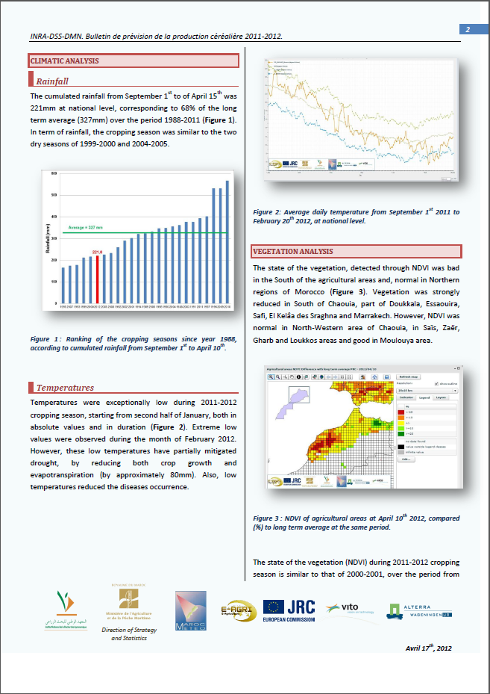
Yield forecasting using remote sensing
Morocco’s first crop yield forecasting bulletin

Slide 8
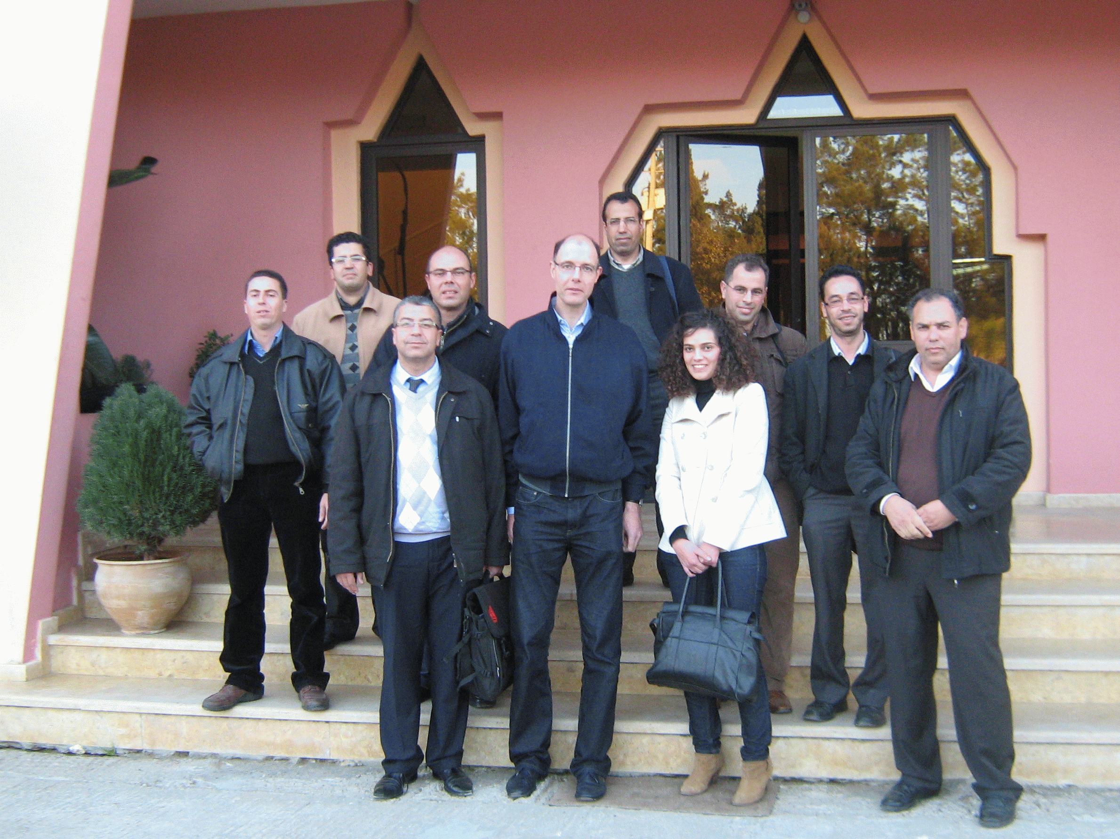
Statistic Tool-box
 | Actors partners | Ground data | Research | Deliv. | Dissemination
Statistical integration for E-Agriculture service | SDLO INRA | Official Statistics | time trend analyses, (multiple) regression analyses and scenario analyses Efficiency of models relative to the trend only Hypothesis testing for determining significance of results | Statistic toolbox | Demo Workshop: Kenitra workshop Training sessions
Achievement:
Good customization of CST, and training

Slide 9
Crop Area Estimation
 | Actors partners | Ground data | Research | Main Output Deliverables | Dissemination
Area estimation using sampling technique and RS | CAAS VITO AIFER INRA | Official Statistics Ground samples | Most accurate statistic models for each target region. The most cost-efficient way in sampling and using remote sensing estimators: Mengcheng Bozhou Kenya | Field sample databases Methodological report Validation with official statistics | Planning a thematic workshop: 27/02/2013
Achievement:
Successful elaboration of new approach, pilot test in Mengcheng and Guoyang
Elaboration of a plan for tests in Kenya
Morocco: existing AFS approach, + new tests?

Slide 10
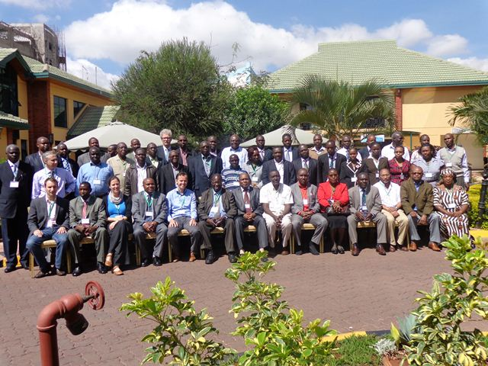
Capacity building in Kenya
 | Actors partners | Ground data | Research | Main Output Deliverables | Networking
Networking and capacity building – Targeted country: Kenya | MEMR VITO In Collaboration with AGRICAB project |  | Improving area estimation: 3 approaches | Feasability and capacity building reports | Joined AGRICAB-EAGRI national workshop in kenya (25-29 Oct. 2012) Vito: C. Tote

Slide 11
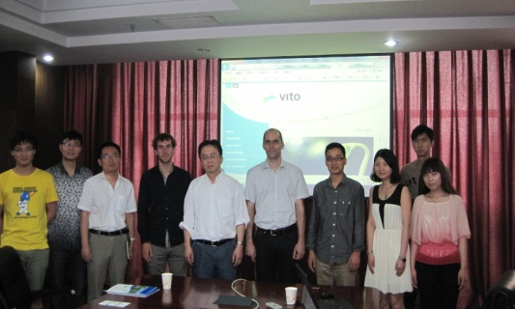

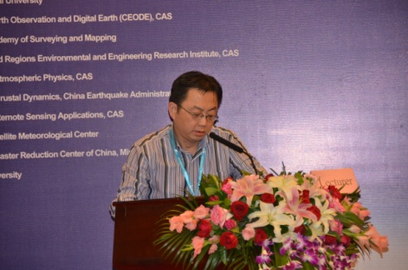
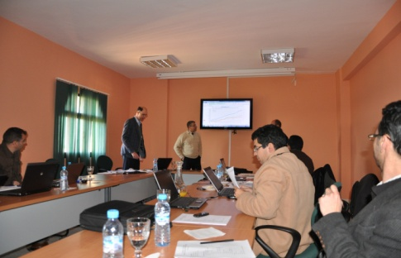

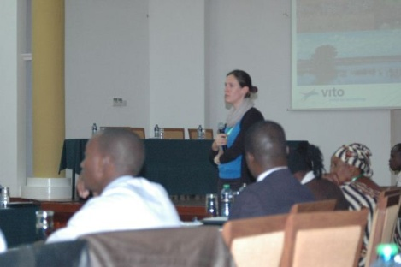
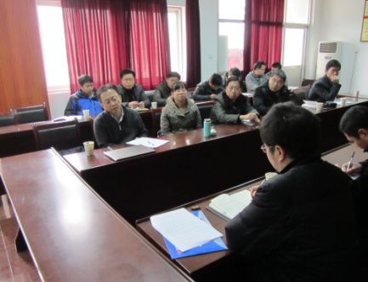

E-AGRI dissemination activities in the 2nd period
External Conference / Workshops | E-AGRI workshops | Networking with other institutions

Slide 12
E-AGRI dissemination activities in the 2nd period
External Conference / Workshops | Networking with other institutions
CAAS: Alterra: UMI: DRSRS, JAAS, AIFER

Slide 13
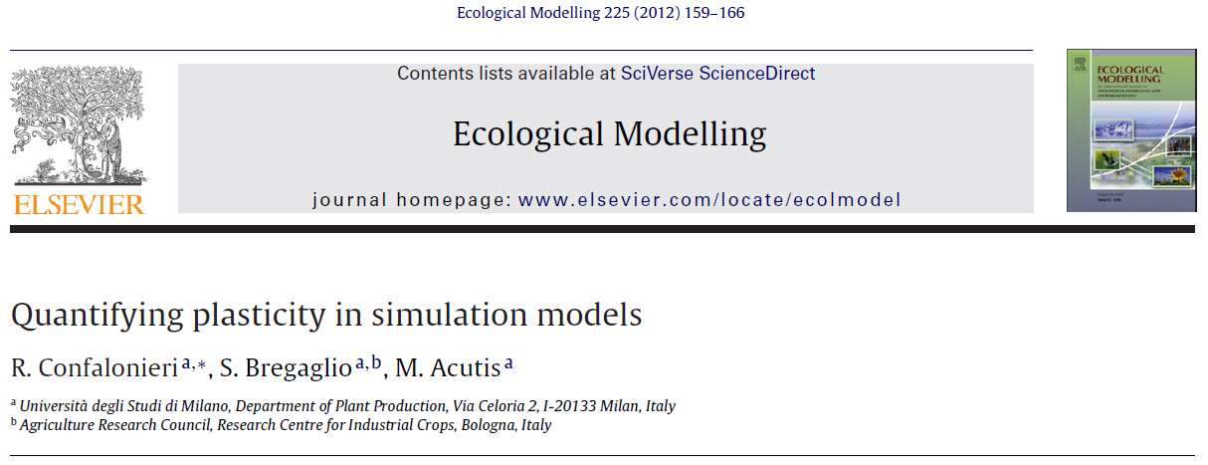
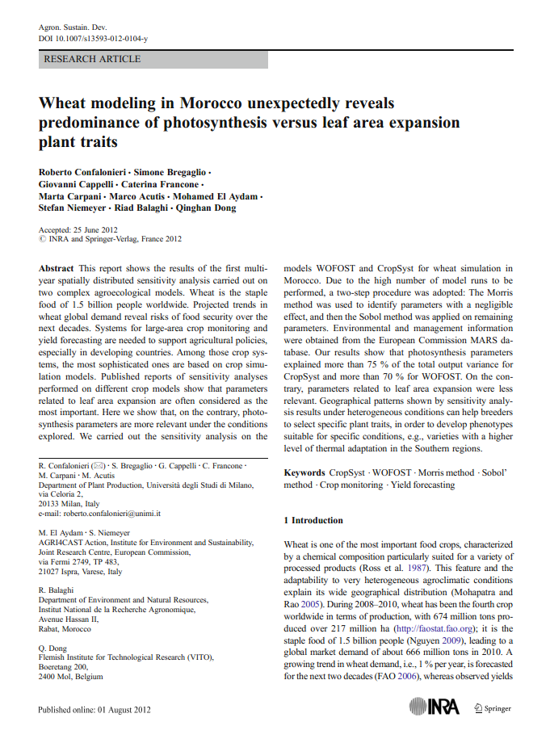
E-AGRI scientific publications
Submissions:
Journal of photogrammetry, remote sensing and geoinformation processing

Slide 14
E-AGRI: Consortium Agreement (CA)

Slide 15
E-AGRI Project Management
Achieved deliverables
Deliverable Number | Deliverable Title | WP | Resp. | Nature | Dissem. level | Delivery status
D21.3 | Regional Statistic Database | 21 | AIFER | R | PP | Approved
D22.1 | Usability reports for application of CGMS for Morocco | 22 | Alterra | R | PP | Approved
D22.2 | Strategy report on CGMS adaptation for Morocco | 22 | Alterra | R | PP | Approved
D23.1 | Usability reports for application of CGMS for Anhui, China | 23 | Alterra | R | PP | Approved
D23.2 | Strategy report on CGMS | 23 | Alterra | R | PP | 31/12/12
D31.1 | Ground data collection report | 31 | JAAS | R | PP | Approved
D32.1 | Sensitivity analyse report | 32 | UMI | R | PU | Approved
D34.1 | Synthetic report on the local crop classification and sensitivity analyses of parametrization | 34 | JRC/UMI | R | PU | Approved
D41.1 | Databases on wheat yield | 41 | AIFER | REMOV |  | Extend ROI
New deliverables:
D71.5 : Dissemination Plan
D62.XX: Building a customized web viewer for e-AGRI (a link possible with the generalist site?)
Could be available:
D61.1, D62.1 (Alterra): Statistics tool box
D71.1 (Alterra); D71.2 (UMI); D71.3 (VITO): Workshops reports

Slide 16
E-AGRI Project Management
Abstracts to prepare for the next deliverables
Deliverable Number | Deliverable Title | WP | Responsible | Nature | Dissemination level | Delivery date
D21.1 | Experimental Database | 21 | AIFER / Alterra | R | PP | 30
D21.2 | Database Report | 21 | AIFER / Alterra | R | PU | 30
D21.4 | Statistical Report | 21 | Alterra | R | PU | 30
D31.2 | Ground information database | 31 | JAAS/UMI | O | CO | 30
D32.2 | Databases for model parameters | 32 | UMI | O | CO | 30
D32.3 | Evaluation report on rice simulation at field level | 32 | UMI | R | PU | 30
D32.4 | Evaluation report on rice simulation on large area | 32 | UMI | R | PU | 30
D34.2 | Databases for parameterisation | 34 | JRC/UMI | O | CO | 30
D34.3 | Evaluation Report on wheat simulation at field level in Morocco | 34 | JRC/UMI | R | PU | 30
D34.4 | Evaluation report on wheat simulation at regional level in Morocco | 34 | JRC/UMI | R | PU | 30
D51.1 | Segment sampling database (Huaibei) | 51 | CAAS | R | CO | 30
D51.2 | Accuracy assessment report on the spatial extrapolation (Huaibei) | 51 | CAAS | R | PP | 30
D52.1 | Databases on using different approaches (Huaibei) | 52 | CAAS | O | CO | 30
D52.2 | Report on the best approach for crop acreage assessment (Huaibei) | 52 | CAAS | R | RE | 30
D53.1 | Segment sampling database for Morocco | 53 | INRA | O | CO | 30
D53.2 | Report on accuracy assessment for the spatial extrapolation for Morocco | 53 | INRA | R | PU | 30
D54.1 | Datasets on area estimates using different approaches (Morocco) | 54 | INRA | O | CO | 30
D54.2 | Report on best approach for crop acreage estimation in the region | 54 | INRA | R | RE | 30
D55.1 | Accuracy and cost-efficiency report | 55 | VITO | R | PU | 30
D61.1 | Report on CGMS statistical toolbox | 61 | Alterra | R | PU | 30

Slide 17
E-AGRI: Project Planning

Slide 18
E-AGRI: 2nd Progress Meeting Agenda
December 10th 2012
09:15: WELCOME SPEACH
09.30 – 10.30: General presentation on the periodic review (Qinghan Dong)
10.30 – 12.00: presentations from WP leaders (WP2 to WP4) on:
activities carried out after the first progress meeting
status of the WP activities and deliverables
actions for the next year
12.00 – 13.30: Lunch
13.30 – 15:00: presentations from WP leaders continued (WP5 to WP7)
15.00 – 16.00: Discussion on weakness underlined by the reviewers during the first periodic review and specific remediation actions
16.00 – 18.00: Discussion on:
action list (could be a summary of the actions mentioned by every WP leader)
interaction between work-packages, between partners / countries
improvable aspects / problems (e.g., communication, delays, etc.) and proposed solutions

Slide 19
E-AGRI: 2nd Progress Meeting Agenda
December 10th 2012
Agreement on the some key topics:
Continued deployment of CGMS in Morocco and achieving the databases for Huaibei
Continued deployment of BioMA in Jiangsu and database completion in Morocco
Yield forecasting in Huaibei, (more prefectures in Henan??), expected outcome should be agreed and a paper
Area estimation in Huaibei, approaches and expert results should be agreed, with outcome a (big) paper together with JRC?
Area estimation in Morocco, keeping current scheme?
Continuation of collaboration after E-AGRI?

Slide 20
A fruitful Collaboration
Grazie
Merci
Bedankt
شكرا
谢谢
asante

